Slide 1
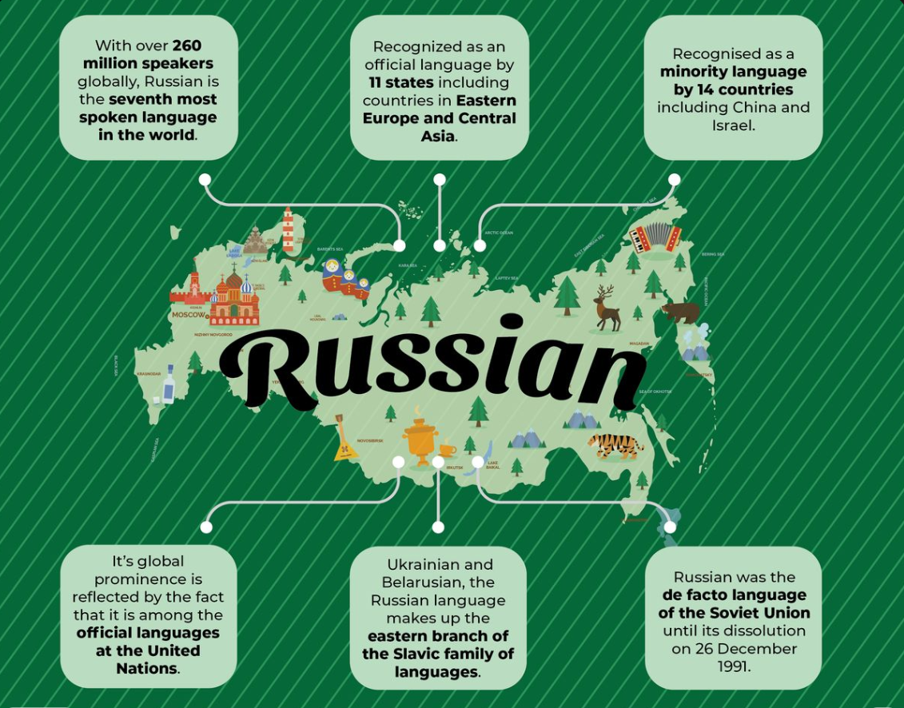
Russian Language.
Overview

Slide 2
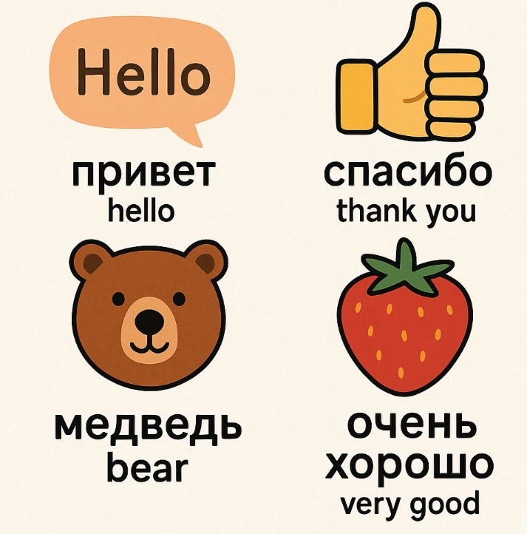
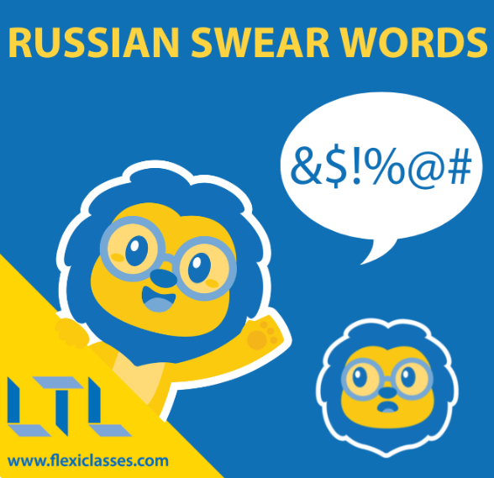
Russian made easy - 5 min
!Use with Caution!

Slide 3
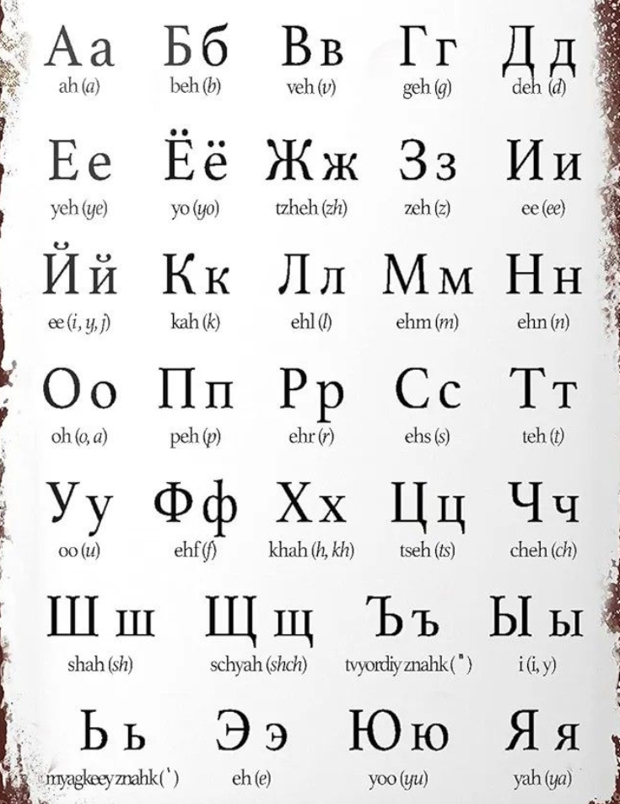
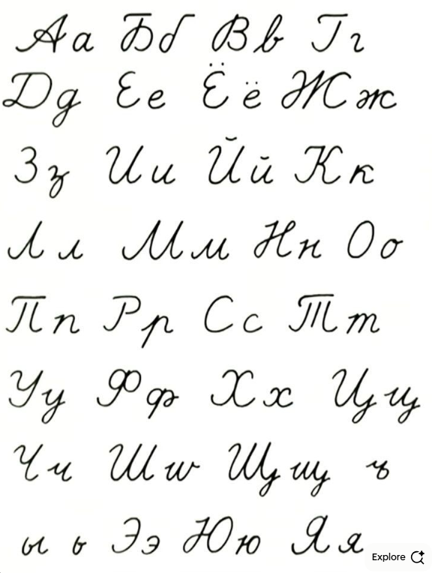
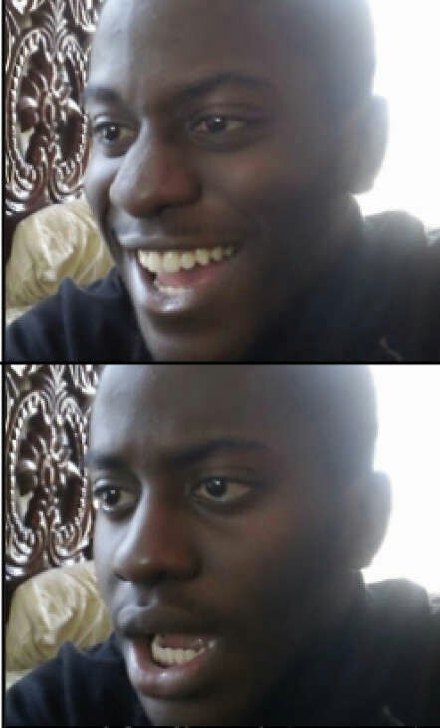
Russian Alphabet
Russian Cursive
+
Notes:
33 letters in the Cyrillic alphabet.

Slide 4
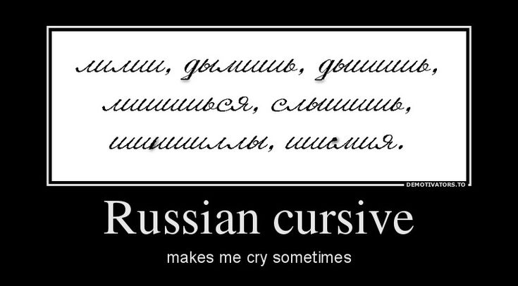

Slide 5
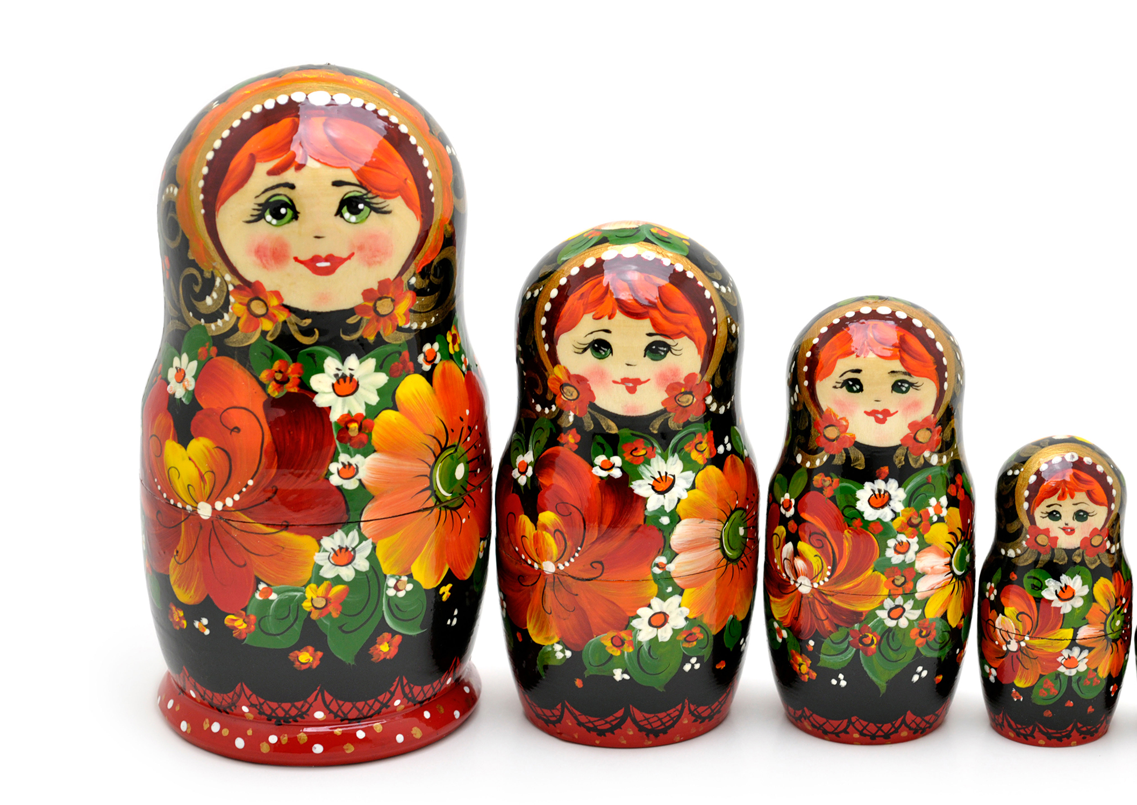
Russian
Language.
Interesting Facts
No articles: Russian has no “a” or “the”.
Free word order: Meaning comes from endings, not position.
Stress is unpredictable: The same word can change meaning when stress moves.
Two signs, no sound: The soft sign (ь) and hard sign (ъ) affect pronunciation but aren’t pronounced.

Slide 6

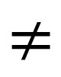
Free word order: Meaning comes from endings, not position.
“The girl loves the boy.”
$$≠$$
“The boy loves the girl.”
Девочка любит мальчика. (neutral)
Мальчика любит девочка. (emphasis on “the boy”)
Любит девочка мальчика. (poetic / expressive)
Девочка мальчика любит. (spoken emphasis)
All four sentences have the same meaning:

Slide 7
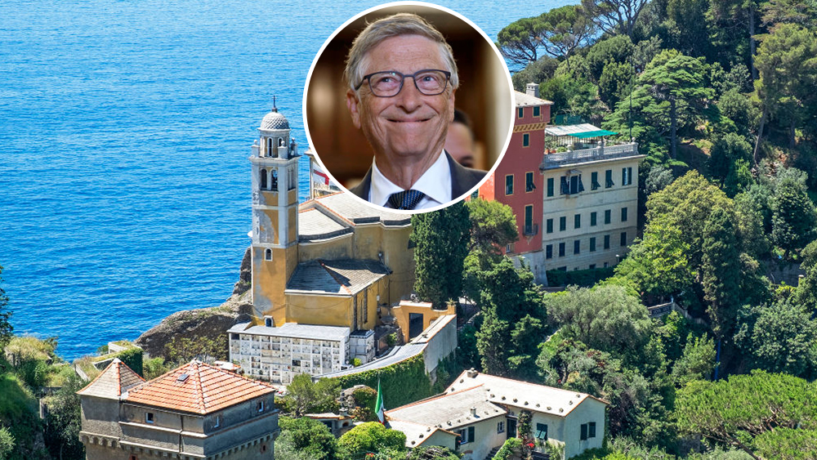

Stress is unpredictable: The same word can change meaning when stress moves.
за́мок — castle
замо́к — lock
му́ка — suffering
мука́ — flour
пла́чу — I cry
плачу́ — I pay
Он купил за́мок. → He bought a castle.
Он купил замо́к. → He bought a lock.

Slide 8

The longest common word often cited:
“превысокомногорассмотрительствующий”
(an extremely over-thoughtful, bureaucratic decision-maker)

Slide 9
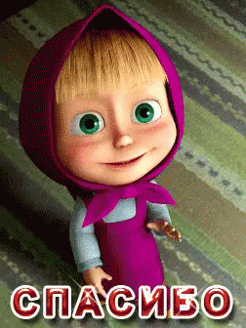
Thank you!
Спасибо (spasibo) !

